Slide 1
Walmart
Machine Learning Sales Forecasting
Presented By: Geetha Kandukuri, Camille Jensen, Tim Philippsen, Kevin Denning, Jill Farley

Slide 2
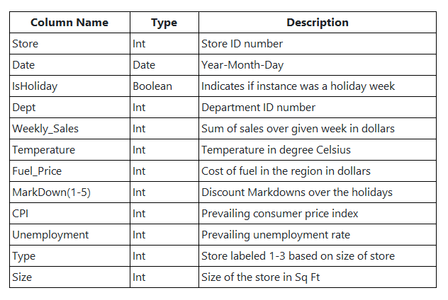
Data Set
Data Source: Walmart Cleaned Data | Kaggle
Data Requirements
Sales related data to predict potential future revenues
Data over time to learn its trends
Varying attributes that impacts trends
Store Types
Type 1: Walmart Discount Store
Type 2: Walmart Neighborhood Store
Type 3: Walmart Supercenters

Slide 3
Objective
Our objective was to produce a model where sales could be forecast with a high degree of accuracy.
Accurate sales forecasting has many benefits for the stakeholder, including:
More informed planning regarding budgeting and resource allocation
Increasing efficiency with proper inventory management, staffing, and production schedules
Better decision making regarding pricing and marketing
Understanding of cash flow cycles knowing when funds are to be received compared to when expenses need to be paid
Customer satisfaction by having the products and services customers are looking for when they need them
All of these benefits help to keep the stakeholder competitive in the marketplace as well as maximize their profitability.

Slide 4
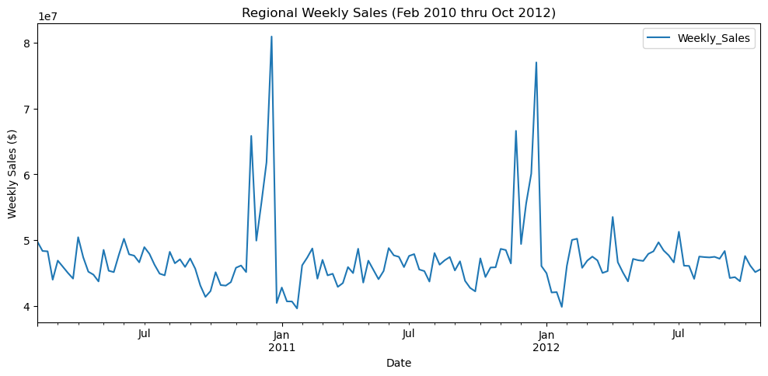
ETL – Data Cleaning
Several modifications were initially made to our dataset including:
Addition of a 'Week of Year' column to identify specific weeks that could be compared year over year as dates change.
The department column was removed to allow for sales to be summed by year and week of year.
Identification of specific holidays including the Superbowl, Labor Day, Thanksgiving, and Christmas. These holidays were identified by our dataset as holidays in a single 'IsHoliday' column. We decided that separating out the holidays to identify further trends was important.
The initial graphing of the data showed a
concentration in sales during holiday seasons,
most notably Thanksgiving and Christmas.

Slide 5
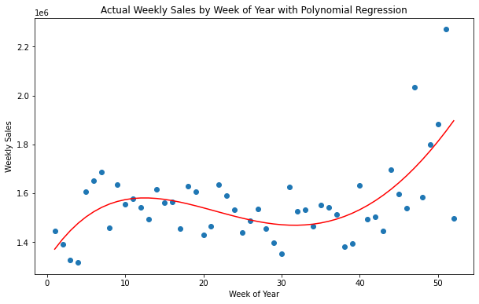
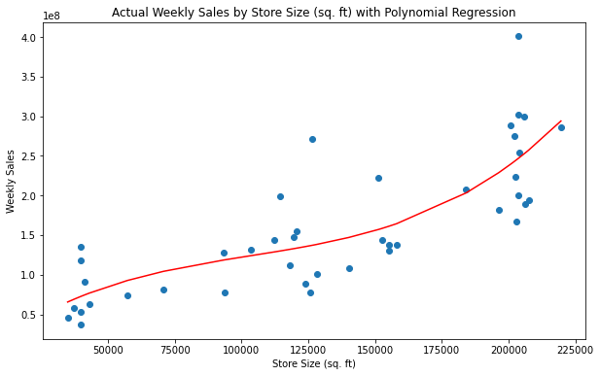
Machine Learning - Polynomial Regression
Our first attempt (bottom left) we tried predicting Weekly Sales vs Week of Year for Store #1 using a polynomial regression model with underperforming results:
R² results were 0.41 and an RMSE of about $125k
Our second attempt (bottom right) we tried predicting Weekly Sales vs Store Size for Store #1 using a polynomial regression model with similarly underperforming results:
R² results were 0.65 and an RMSE of about $50M
Model was limited due to predicting on only two features at a time as well as predicting on one store out of the 45 in our dataset.

Slide 6
Machine Learning – RandomForest Regression
We changed our model from a Polynomial Regression model to a RandomForest Regression model due to the latter providing better results with larger datasets. We used our model to predict across all years in our dataset (2010-2012), and saved results in SQL DB. Model saved to use for future predictions without having to retrain.
With this change also came additional transforming of the data:
Additional 'Holiday' Periods
In addition to the initial holidays the dataset provided additional 'holiday' time periods were added. IS_NEAR_EASTER, IS_NEAR_TGIVING, and IS_NEAR_XMAS were all added to our final data frame.
These additional 'holidays' were added as we noticed a trend where sales didn't necessarily spike during the week of the holiday but in the week or weeks before the holiday.
Markdowns
Markdown information was averaged and provided for all time periods based on the markdown information we had for the specific week of year. While our initial dataset did not include markdown values for 2010 or most of 2011, our averaged markdown was included in all years of our dataset.
One week did not include any markdown information, week 44.
Weekly Sales Lag
A lag in sales was included to help predict sales based on the prior week or 4 weeks of sales.

Slide 7
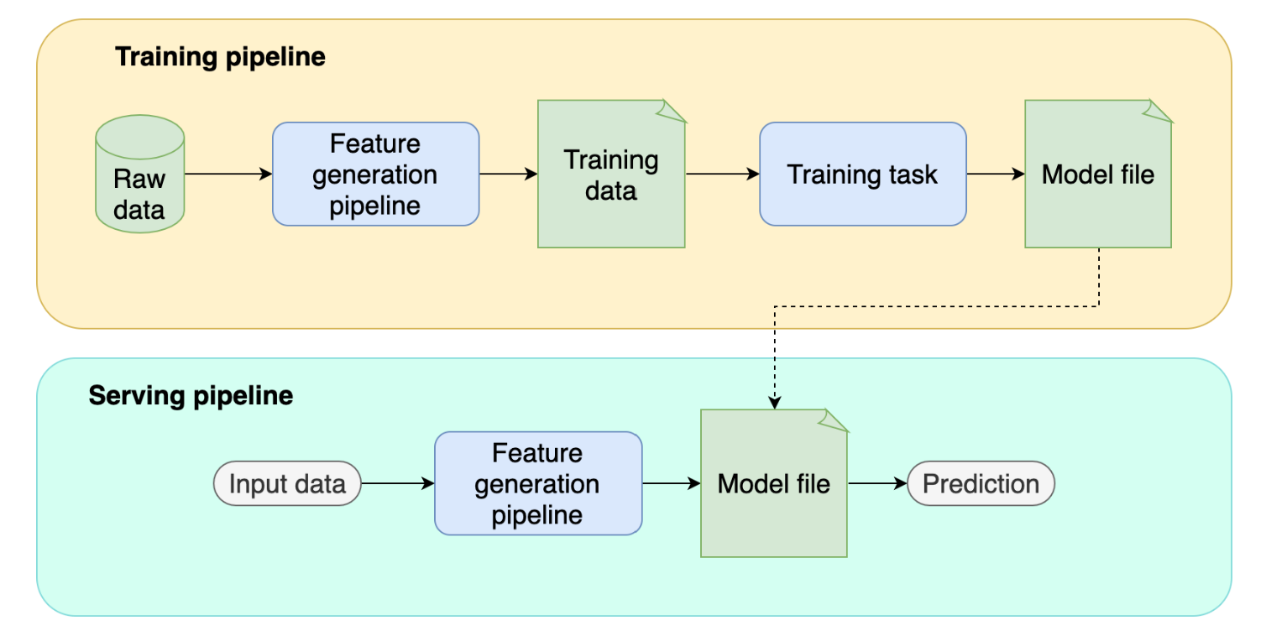
Machine Learning – Modeling Steps

Slide 8
Performance Optimization
Feature Tuning
Hyperparameter Tuning
Count | RMSE | R2 | Adj-R2 | Features
11 | 4.38 mil | 0.49 |  | Basic, no MDs
13 | 3.89 mil | 0.60 | 0.56 | Near Xmas,TG
14 | 3.85 mil | 0.61 | 0.57 | Lag1 (1 week)
15 | 3.69 mil | 0.64 | 0.60 | Lag4 (4 weeks)
16 | 3.61 mil | 0.66 | 0.61 | Near Easter
21 | 3 mil | 0.76 | 0.72 | Markdowns 1-5
Trees | RMSE | R2 | Other Parms
200 | 3.04 mil | 0.75 | Defaults used
500 | 3.01 mil | 0.76 | Defaults used
1000 | 3.03 mil | 0.76 | Defaults used
1500 | 3.03 mil | 0.75 | Defaults used
n_estimators: [500, 1000] min_samples_split: [2, 4, 7] min_samples_leaf: [1, 2, 4] max_features: ['auto', 2, 5, 7] run thru GridSearchCV
500 | 3.01 mil | 0.76 | Final set of parameters: n_estimators: 500 max_features: 'auto' (default) min_samples_split: 2 (default) min_samples_leaf: 1 (default)
Training data used for GridSearchCV

Slide 9
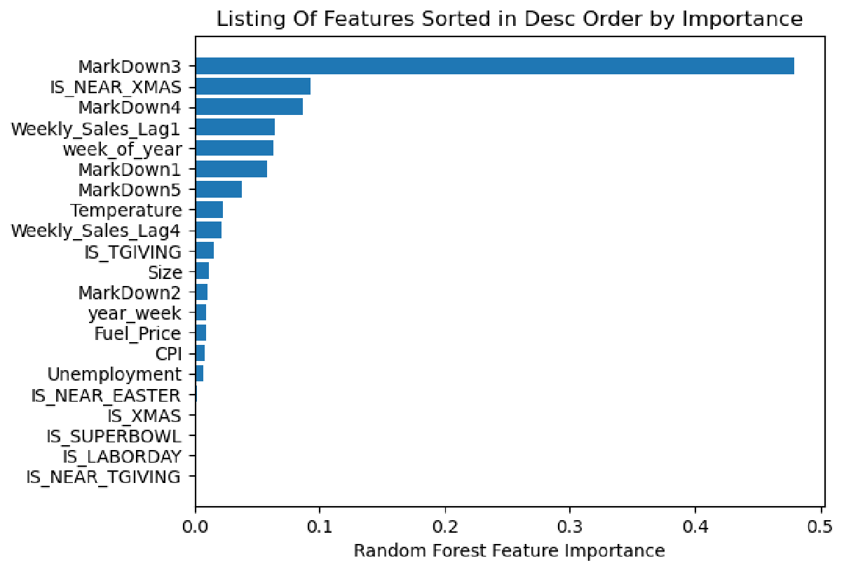
Review of Feature Importance
Feature Importance based on MDI (Mean decrease in Impurity)
Explains how each feature contributes to the end value
Can be used for feature selection in case of very high number of features
Improve and enhance model if the highly important feature is missing value or missing for training or data used in predictions
Measured on a scale from 0 to 1, 1 being highly important
Should not be interpreted as strong coefficients as they do not represent a dependency with target

Slide 10
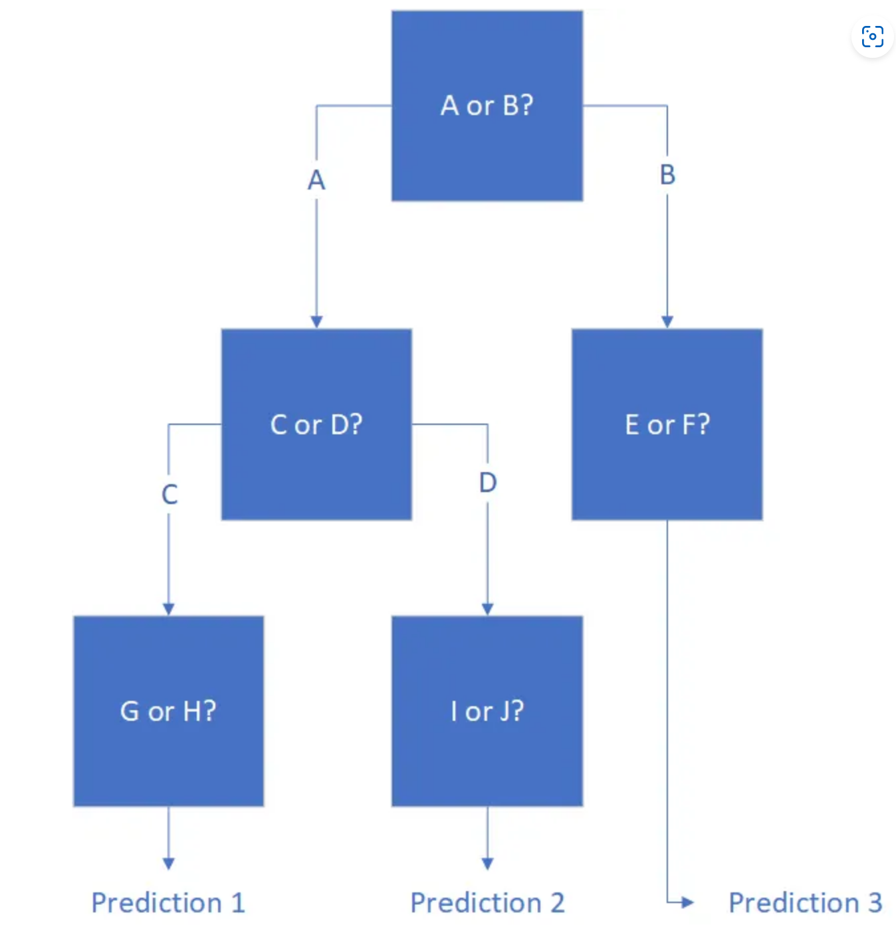
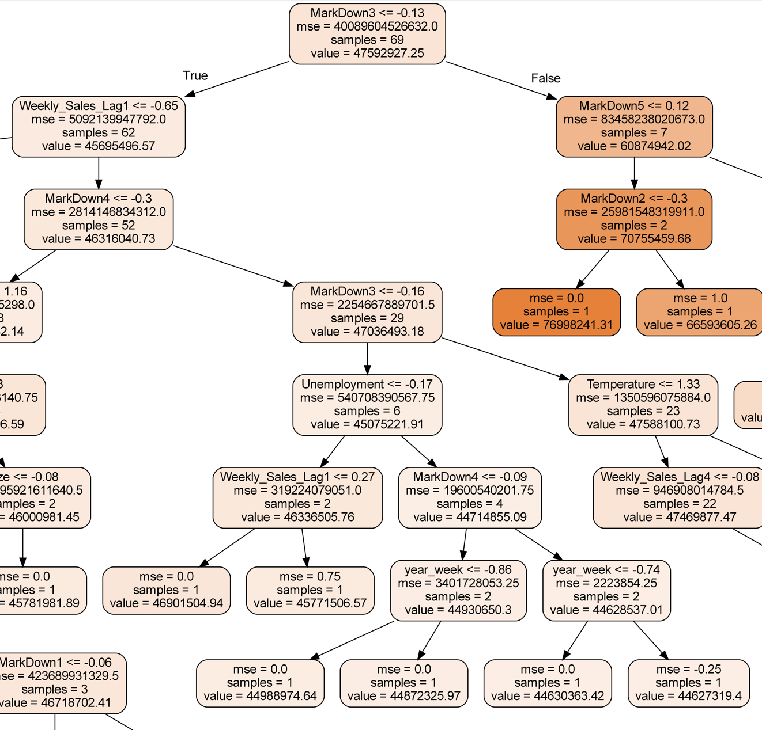
Visual of an Individual Decision Tree from Model

Slide 11
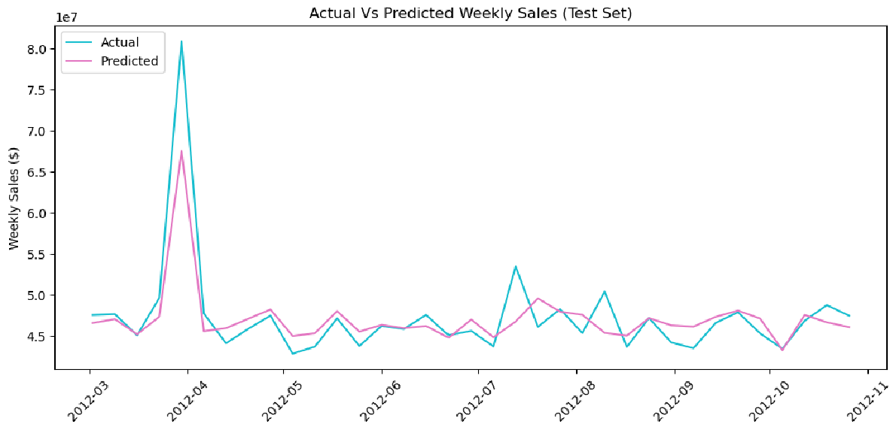
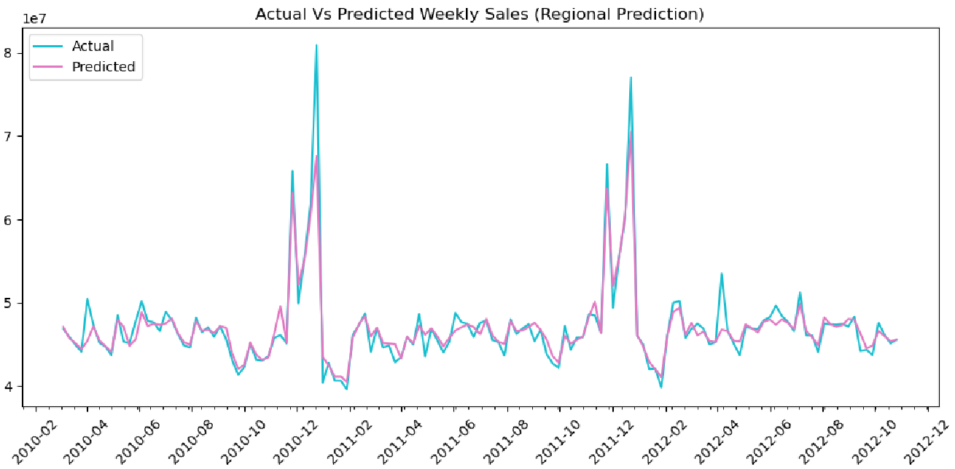
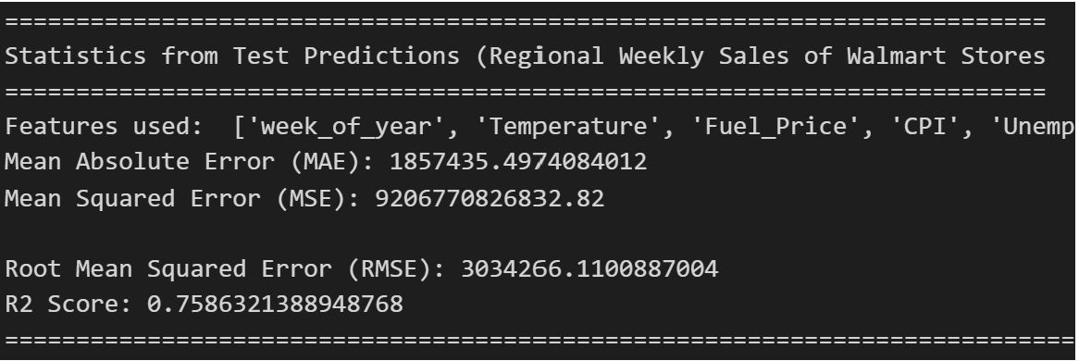
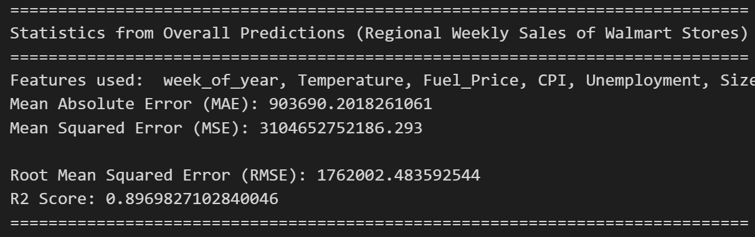
Predicted Results (Test-set & Entire Dataset)

Slide 12
Conclusion
Utilizing a RandomForest model we were able to explain 89% of the variance with an R² of 0.897 indicating its effectiveness.
Through optimizing the model we determined that performance could be enhanced with markdown values. Real markdown values for all years would likely improve the results.
Based on the final_predictions.csv, our total sales amount to approximately 6.5 billion.
Our RandomForest model produced a deviation of around a $1.76 million, or 0.15%, which is a reasonably good result for the model's accuracy.
While the model may be useful in providing an estimate of future sales, it is important to keep in mind its limitations and potential sources of error. Further analysis and refinement of the model may help improve its accuracy in predicting sales.

Slide 13
Data Limitation
Time Periods Provided: February 2010 – October 2012
The beginning of the dataset began in February due to Walmart's fiscal year beginning in February.
The dataset only had 2 years of Thanksgiving and Christmas sales due to ending in October 2012.
Holiday outliers
Holidays may not fall on the same week number with several holidays not remaining on the same date every year (Superbowl, Labor Day, Thanksgiving)
Missing markdown values for 2010 and most of 2011
Markdowns were determined to have a significant impact on our predicted results.
No further information was provided as to what Markdowns pertained to and how they were determined.
Store location is unknown and model built with assumption that stores are from the same region.
No geographical data was provided to identify the location of stores to better understand demographic and census information for each store.

Slide 14
Data Limitation (continued)
Departments were not identified (however we found a list that identified most of them) and were dropped from our analysis.
The ability to utilize sales by department could have led to a better forecasting model and better predictions at varying times of the year for each department.
Length of operation for each store
How long each store has been open would be important to note in a forecasting model as new locations may not perform as well, or may perform better than, existing locations due to other factors.

Slide 15
Questions?

Slide 16
Thank you

